Slide 1










Denmark
Switzerland
Georgia
Turkey
Latvia
Austria
Albania
Poland
Malta
Monaco

Slide 2








Bulgaria
Hungary
Italy
Portugal
Belarus
Azerbaijan
Ireland
Lithuania

Slide 3







United Kingdom
Norway
Iceland
France
Czech Republic
Luxembourg
Liechtenstein

Slide 4



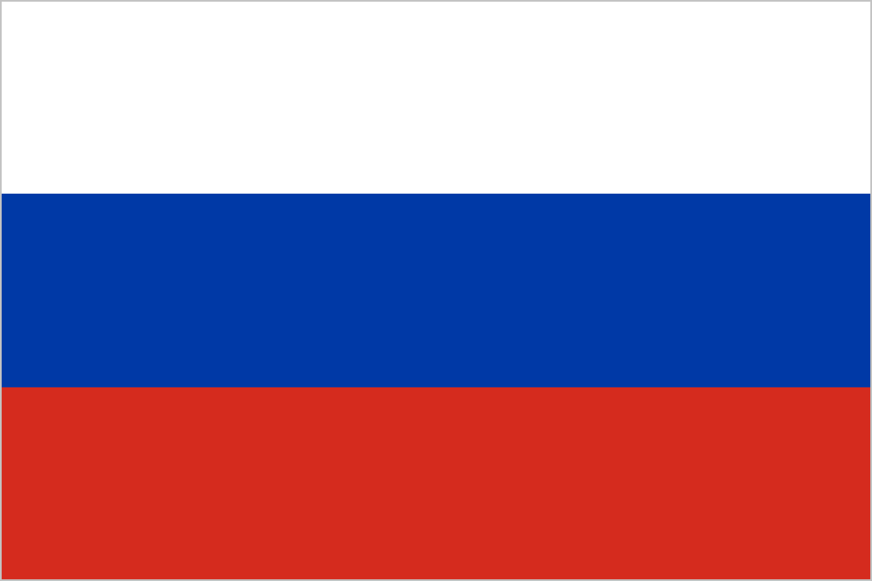


Netherlands
Croatia
Serbia
Russia
Slovakia
Slovenia

Slide 5









Finland
Greece
Estonia
San Marino
Kazakhstan
Kosovo
Sweden
Ukraine
Bosnia and Herzegovina

Slide 6










Germany
Belgium
Vatican City
Armenia
Romania
Andorra
Moldova
Spain
North Macedonia
Montenegro

